Slide 1
An efficient ECG signals denoising technique based on the combination of particle swarm optimisation and wavelet transform

Slide 2
Introduction
Electrocardiogram (ECG) signals represent the electrical activity of the heart
ECG signals are non-stationary in nature
They are often corrupted by noise during acquisition
Noise affects diagnosis accuracy
Therefore, effective noise removal is essential

Slide 3
Problem Statement
The main problem is to effectively remove noise from non-stationary ECG signals without distorting important cardiac features by optimally selecting wavelet denoising parameters.

Slide 4
Objectives
Main Objective:
To reduce noise in ECG signals using Wavelet Transform
Sub Objectives:
Decompose ECG signal into multiple levels
Apply thresholding to remove noise
Reconstruct denoised ECG signal

Slide 5
Noise Model
When a signal is acquired or transmitted over a distance, it is frequently contaminated by noise due to environmental and system-related factors.
According to the additive noise model, the observed (contaminated) signal is expressed as:
ECGnoisy(n)=s(n)+δe(n)
s(n) represents the clean ECG signal
e(n) represents the noise
δ represents the amplitude of the noise,
n is the sample number

Slide 6
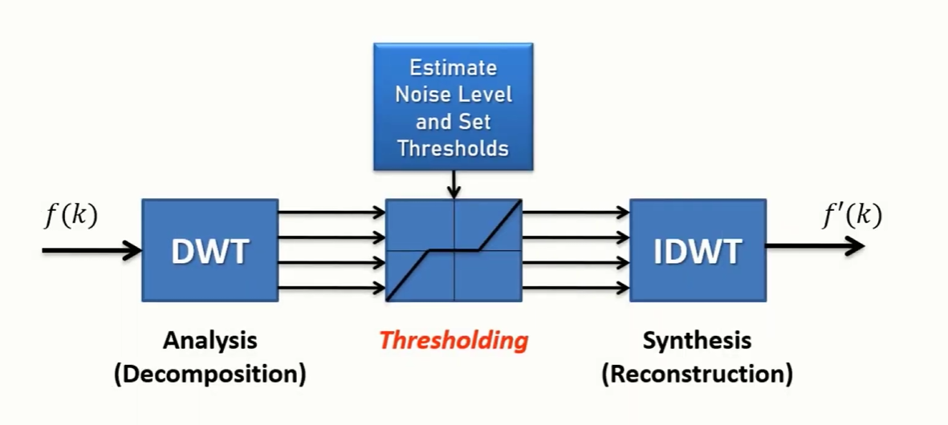
Methodology

Slide 7
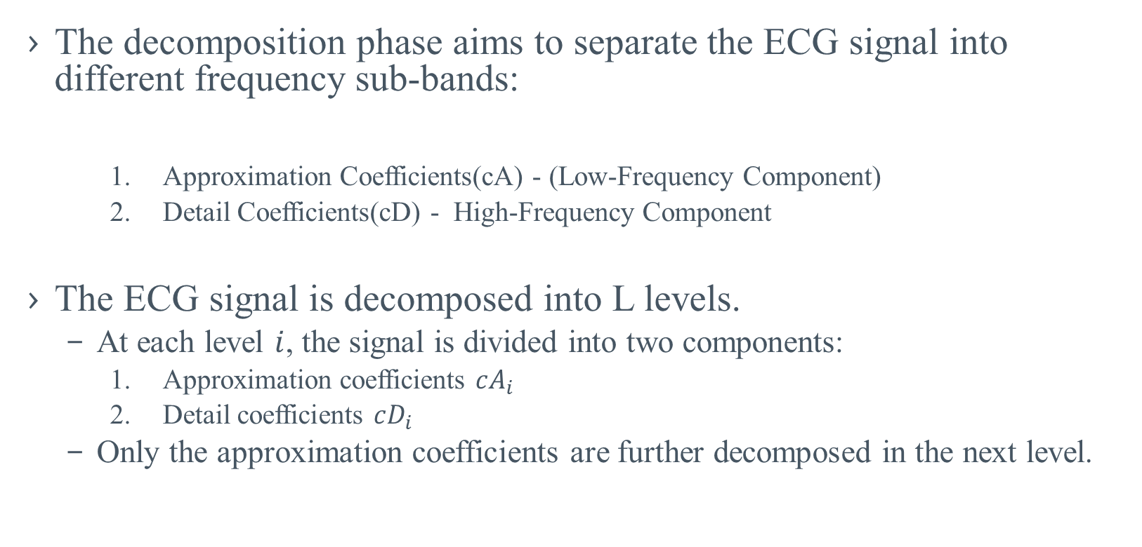
Decomposition
The decomposition phase aims to separate the ECG signal into different frequency sub-bands:
Approximation Coefficients(cA) - (Low-Frequency Component)
Detail Coefficients(cD) - High-Frequency Component
The ECG signal is decomposed into L levels.
At each level $i$, the signal is divided into two components:
Approximation coefficients $cA_{i}$
Detail coefficients $cD_{i}$
Only the approximation coefficients are further decomposed in the next level.

Slide 8


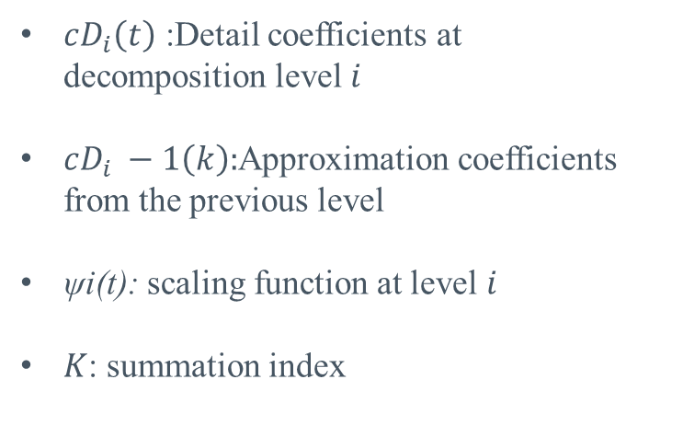

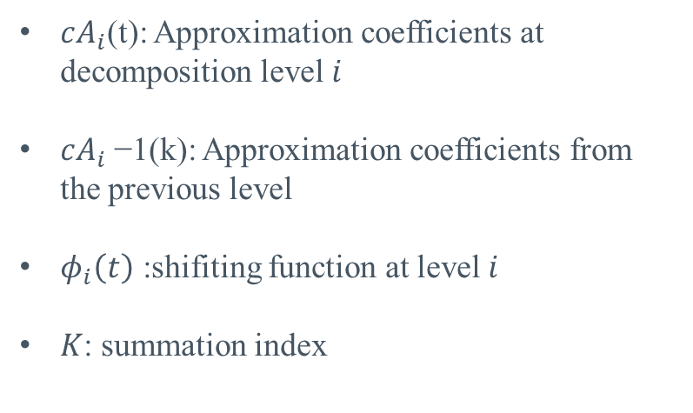
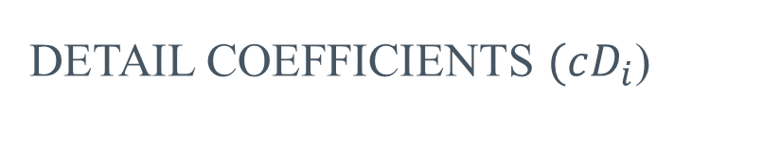
Decomposition
Approximation coefficients ($cA_{i}$)
Detail coefficients $(cD_{i}$)
$cD_{i}\left(t\right)$: Detail coefficients at decomposition level $i$
$cD_{i} −1​\left(k\right):$Approximation coefficients from the previous level
ψi​(t): scaling function at level $i$
$K$: summation index
$cA_{i}$(t): Approximation coefficients at decomposition level $i$
$cA_{i}$−1​(k): Approximation coefficients from the previous level
$φ_{i}\left(t\right)$: shifiting function at level $i$
$K$: summation index

Slide 9
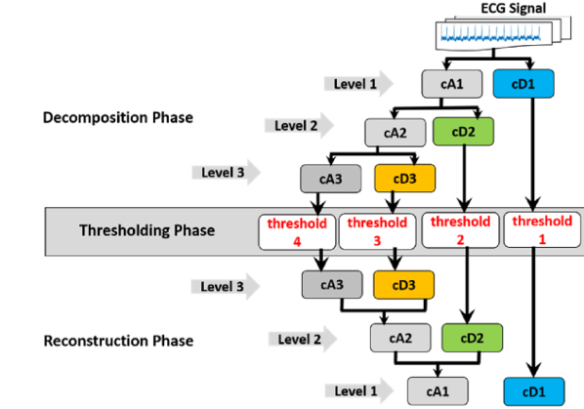
Total workflow

Slide 10
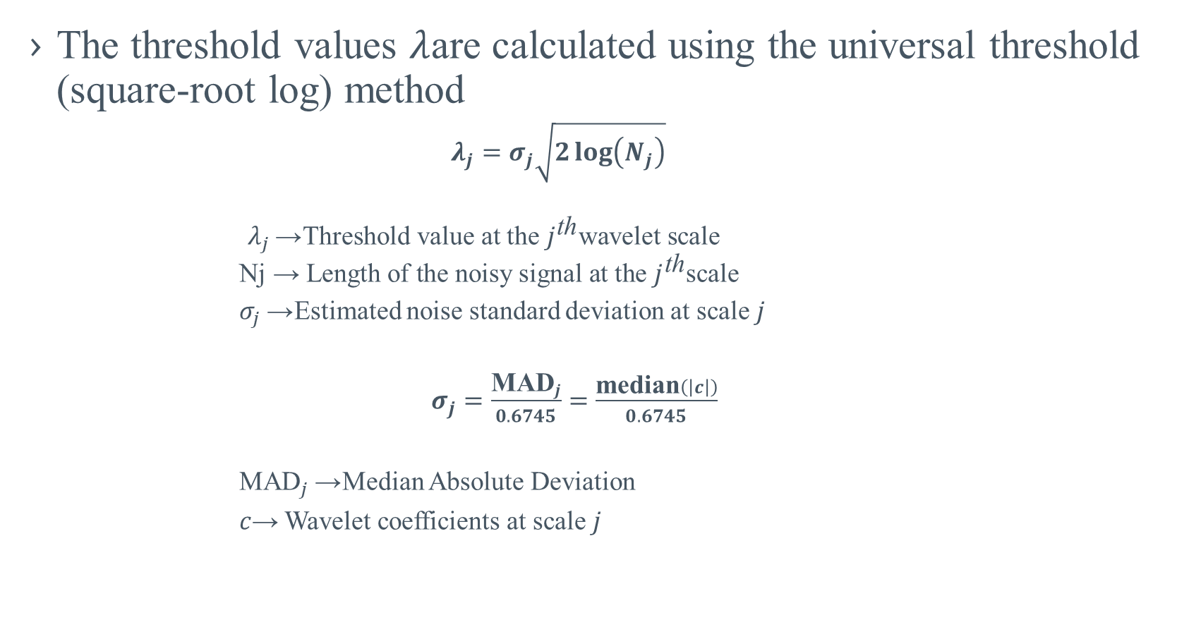
Thresholding
The threshold values $λ$are calculated using the universal threshold (square-root log) method
$λ_{j}=σ_{j}\sqrt{2\log\left(N_{j}\right)}$
$$λ_{j}\text{→ }\text{Threshold} \text{value} \text{at} \text{the} j^{\text{th}}\text{wavelet} \text{scale}$$
$$\text{Nj}\text{​ }\text{→ }\text{Length} \text{of} \text{the} \text{noisy} \text{signal} \text{at} \text{the} j^{\text{th}}\text{scale}$$
$σ_{j}$→ Estimated noise standard deviation at scale $j$
$σ_{j}=\frac{{\text{MAD}}_{j}}{0.6745}=\frac{\text{median}\left(\left|c\right|\right)}{0.6745}$
${\text{MAD}}_{j}$→ Median Absolute Deviation
$c$→ Wavelet coefficients at scale $j$

Slide 11
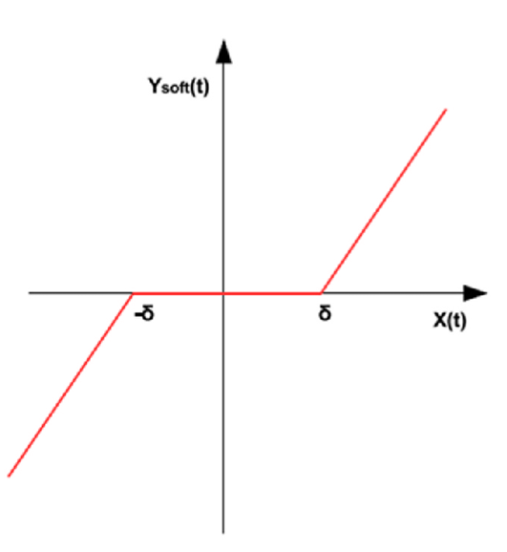
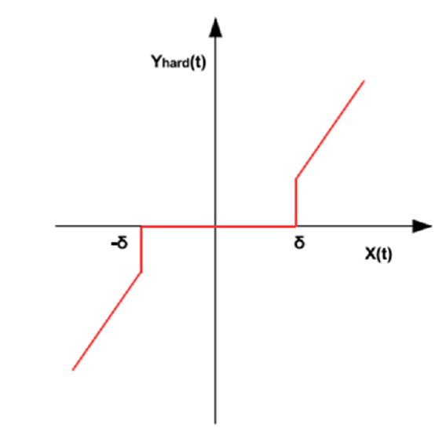


Thresholding
Hard Thresholding
Soft Thresholding

Slide 12
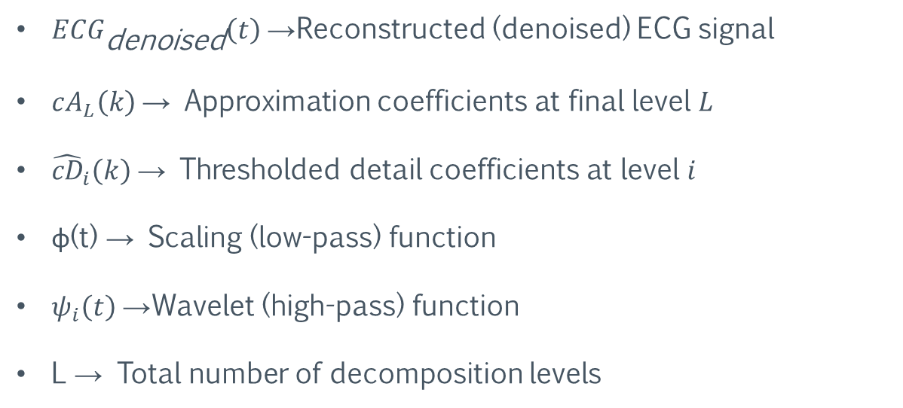
Reconstruction
$$ECG_{\text{denoised}}\left(t\right)=\sum_{k=−∞}^{∞}{cA_{L}\left(k\right)} φ\left(t−k\right) +\sum_{i=1}^{L}{\sum_{=−∞}^{∞}{\hat{cD_{i}}\left(k\right)}} ψ_{i}\left(t−k\right)$$
$ECG_{\text{denoised}}\left(t\right)$→ Reconstructed (denoised) ECG signal
$cA_{L}\left(k\right)$→ Approximation coefficients at final level $L$
${\hat{cD}}_{i}\left(k\right)$→ Thresholded detail coefficients at level $i$
ϕ(t) → Scaling (low-pass) function
$ψ_{i}\left(t\right)$→ Wavelet (high-pass) function
L → Total number of decomposition levels

Slide 13
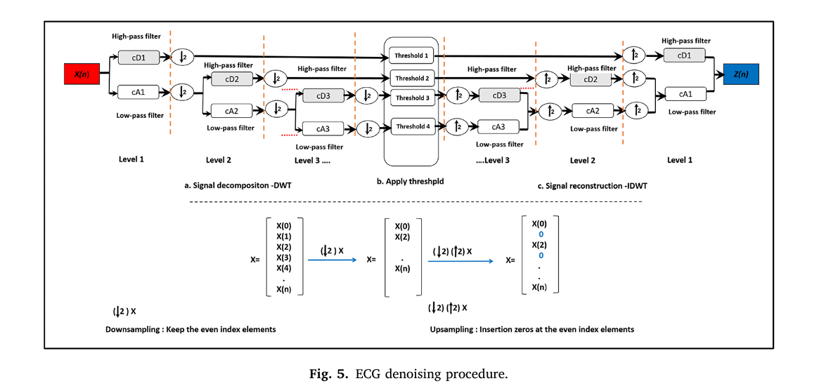
Downsampling and Upsampling

Slide 14
Conclusion
ECG signals are affected by noise like WGN and Power Line Interference
Wavelet Transform is good for ECG denoising.
The method improves ECG quality by giving higher SNR and lower PRD
The approach performs and removes both PLI and WGN noise effectively

Slide 15
Thank You

